Slide 1
Fundamentals of Statistics for Sampling Methods
Alfonso Cavallo

Slide 2

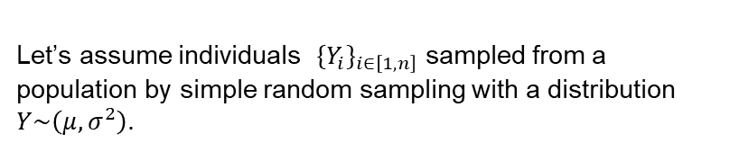

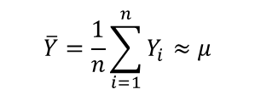






Estimating the Population's Distribution
Let’s assume individuals ${{\{Y}_{i}\}}_{i∈\left[1,n\right]}$ sampled from a population by simple random sampling with a distribution $Y\sim \left(μ,σ^{2}\right)$.
Mean and variance of the distribution are the unknown properties we’d like to compute.
$$μ−3σ$$
$$μ$$
$$μ+3σ$$
$$Y_{3}$$
$$Y_{4}$$
$$Y_{0}$$
$$Y_{1}$$
$$Y_{2}$$
$$Y_{4}$$
The arithmetic average is one possible estimator the population mean.
$$\overline{Y}=\frac{1}{n}\sum_{i=1}^{n}{Y_{i}}≈μ$$

Slide 3

Estimating the Population's Distribution
Is the estimator (arithmetic average) unbiased?
$$𝔼\left[\overline{Y}\right]=𝔼\left[\frac{1}{n}\sum_{i=1}^{n}{Y_{i}}\right]=\frac{1}{n}\sum_{i=1}^{n}{𝔼\left[Y_{i}\right]}=\frac{1}{n}n⋅μ=μ$$
$$μ−3σ$$
$$μ$$
$$μ+3σ$$
$$Y_{3}$$
$$Y_{4}$$
$$Y_{0}$$
$$Y_{1}$$
$$Y_{2}$$
$$Y_{4}$$
The expected value for the arithmetic average is exactly the distribution’s mean. The estimator is unbiased.

Slide 4
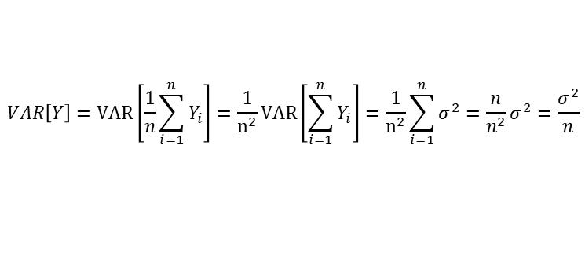
Estimating the Population's Distribution
What is the estimator’s variance?
$$VAR\left[\overline{Y}\right]=VAR\left[\frac{1}{n}\sum_{i=1}^{n}{Y_{i}}\right]=\frac{1}{n^{2}}VAR\left[\sum_{i=1}^{n}{Y_{i}}\right]=\frac{1}{n^{2}}\sum_{i=1}^{n}{σ^{2}}=\frac{n}{n^{2}}σ^{2}=\frac{σ^{2}}{n}$$
$$μ−3σ$$
$$μ$$
$$μ+3σ$$
The fundamental takeaway is that the variance for the arithmetic average is:
Proportional to the variance of the distribution. The more the variance, the higher probability that the picked population’s estimated mean deviates from its true value.
Inversely proportional to the number of osservation. Each observation explains more of the distribution’s variance. If it tends to zero, then the estimator is exact.
$$Y_{3}$$
$$Y_{4}$$
$$Y_{0}$$
$$Y_{1}$$
$$Y_{2}$$
$$Y_{4}$$

Slide 5
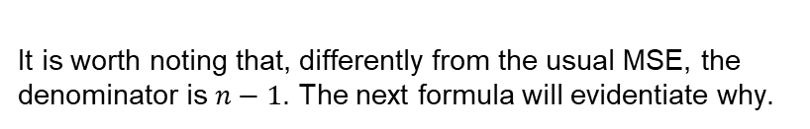
Estimating the Population's Distribution
The variance of the distribution can be computed as a Mean Square Error (MSE):
$s^{2}=\sum_{i=1}^{n}{\frac{{\left(y_{i}−\overline{y}\right)}^{2}}{n−1}}$ $with \overline{y}=\frac{\sum_{i=1}^{n}{y_{i}}}{n}$
$$μ−3σ$$
$$μ$$
$$μ+3σ$$
$$Y_{3}$$
$$Y_{4}$$
$$Y_{0}$$
$$Y_{1}$$
$$Y_{2}$$
$$Y_{4}$$
It is worth noting that, differently from the usual MSE, the denominator is $n−1$. The next formula will evidentiate why.

Slide 6

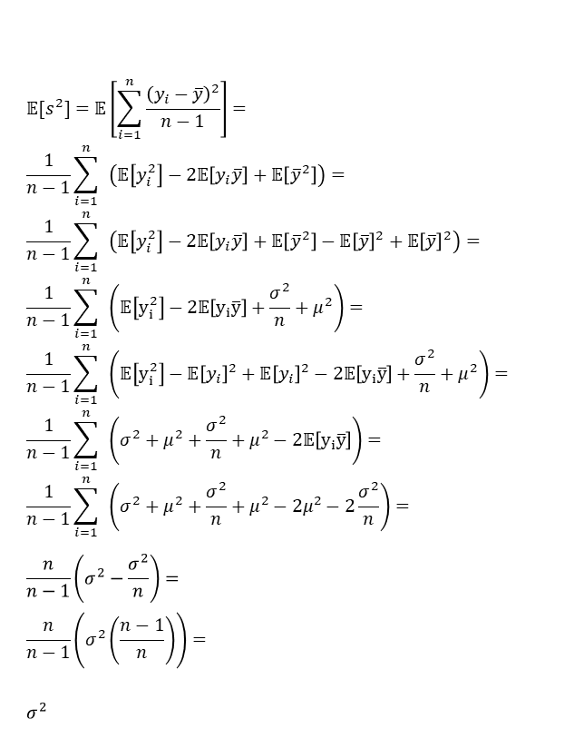
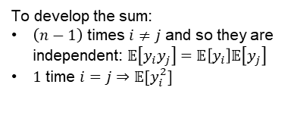
Is the MSE an unbiased estimator for the variance?
$${𝔼[s}^{2}]=𝔼\left[\sum_{i=1}^{n}{\frac{{\left(y_{i}−\overline{y}\right)}^{2}}{n−1}}\right]= \\ \frac{1}{n−1}\sum_{i=1}^{n}{ }\left(𝔼\left[y_{i}^{2}\right]−2𝔼\left[y_{i}\overline{y}\right]+𝔼\left[{\overline{y}}^{2}\right]\right)= \\ \frac{1}{n−1}\sum_{i=1}^{n}{ }\left(𝔼\left[y_{i}^{2}\right]−2𝔼\left[y_{i}\overline{y}\right]+𝔼\left[{\overline{y}}^{2}\right]−𝔼{\left[\overline{y}\right]}^{2}+𝔼{\left[\overline{y}\right]}^{2}\right)= \\ \frac{1}{n−1}\sum_{i=1}^{n}{ }\left(𝔼\left[y_{i}^{2}\right]−2𝔼\left[y_{i}\overline{y}\right]+\frac{σ^{2}}{n}+μ^{2}\right)= \\ \frac{1}{n−1}\sum_{i=1}^{n}{ }\left(𝔼\left[y_{i}^{2}\right]−𝔼{\left[y_{i}\right]}^{2}+𝔼{\left[y_{i}\right]}^{2}−2𝔼\left[y_{i}\overline{y}\right]+\frac{σ^{2}}{n}+μ^{2}\right)= \\ \frac{1}{n−1}\sum_{i=1}^{n}{ }\left(σ^{2}+μ^{2}+\frac{σ^{2}}{n}+μ^{2}−2𝔼\left[y_{i}\overline{y}\right]\right)= \\ \frac{1}{n−1}\sum_{i=1}^{n}{ }\left(σ^{2}+μ^{2}+\frac{σ^{2}}{n}+μ^{2}−{2μ}^{2}−2\frac{σ^{2}}{n}\right)= \\ \frac{n}{n−1}\left(σ^{2}−\frac{σ^{2}}{n}\right)= \\ \frac{n}{n−1}\left(σ^{2}\left(\frac{n−1}{n}\right)\right)= \\ σ^{2}$$
$$𝔼\left[y_{i}\overline{y}\right]= \\ 𝔼\left[y_{i}\sum_{j=1}^{n}{\frac{y_{j}}{n}}\right]= \\ \frac{1}{n}\sum_{j=1}^{n}{𝔼[y_{i}y_{j}]}= \\ \frac{1}{n}\left(\left(n−1\right)𝔼\left[y_{i}\right]𝔼\left[y_{j}\right]+𝔼\left[y_{i}^{2}\right]\right)= \\ \frac{1}{n}\left(\left(n−1\right)μ^{2}+𝔼\left[y_{i}^{2}\right]−𝔼{\left[y_{i}\right]}^{2}+𝔼{\left[y_{i}\right]}^{2}\right)= \\ \frac{1}{n}\left(\left(n−1\right)μ^{2}+σ^{2}+μ^{2}\right)= \\ \frac{1}{n}\left(nμ^{2}+σ^{2}\right)= \\ μ^{2}+\frac{σ^{2}}{n}$$
To develop the sum:
$\left(n−1\right)$ times $i≠j$ and so they are independent: $𝔼\left[y_{i}y_{j}\right]=𝔼\left[y_{i}\right]𝔼\left[y_{j}\right]$
$1$ time $i=j⇒𝔼[y_{i}^{2}]$
It is exactly equal to the actual variance, which means it is unbiased.

Slide 7
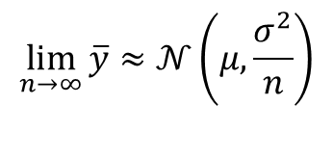
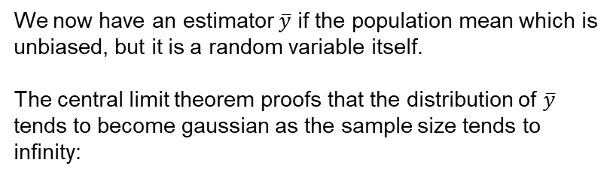
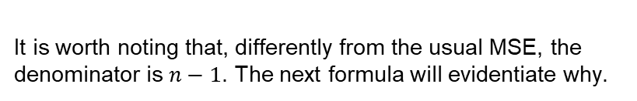
Central Limit Theorem
We now have an estimator $\overline{y}$ if the population mean which is unbiased, but it is a random variable itself.
The central limit theorem proofs that the distribution of $\overline{y}$ tends to become gaussian as the sample size tends to infinity:
$$\lim_{n→∞}{\overline{y}}≈𝒩\left(μ,\frac{σ^{2}}{n}\right)$$
It is worth noting that, differently from the usual MSE, the denominator is $n−1$. The next formula will evidentiate why.

Slide 8
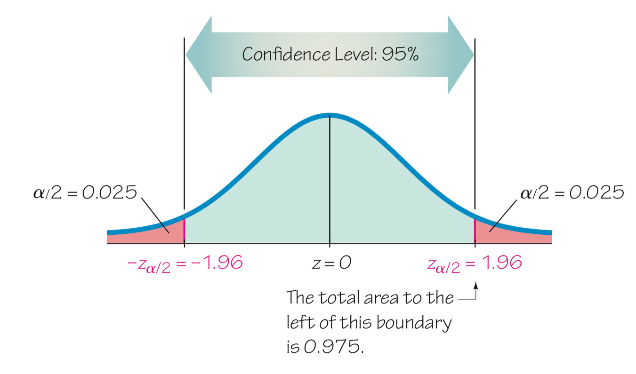
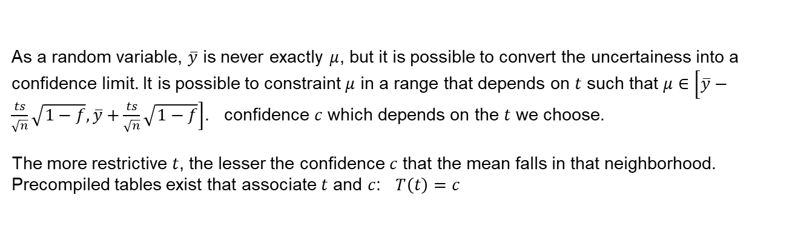
Central Limit Theorem
As a random variable, $\overline{y}$ is never exactly $μ$, but it is possible to convert the uncertainess into a confidence limit. It is possible to constraint $μ$ in a range that depends on $t$ such that $μ∈\left[\overline{y}−\frac{ts}{\sqrt{n}}\sqrt{1−f}, \overline{y}+\frac{ts}{\sqrt{n}}\sqrt{1−f}\right]$. confidence $c$ which depends on the $t$ we choose.
The more restrictive $t$, the lesser the confidence $c$ that the mean falls in that neighborhood.
Precompiled tables exist that associate $t$ and $c$: $T\left(t\right)=c$

Slide 9
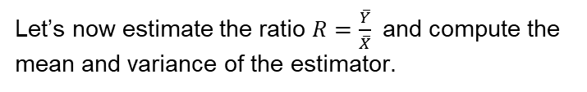

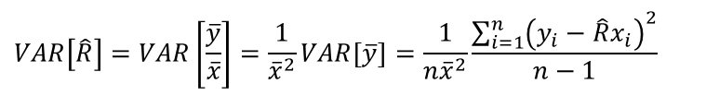
Estimator of the Ratio
Let’s now estimate the ratio $R=\frac{\overline{Y}}{\overline{X}}$and compute the mean and variance of the estimator.
$$\hat{R}=\frac{\overline{y}}{\overline{x}}$$
Start from the assumption that $n$ is big and thus $\overline{x}$ can be treated as a constant, the actual $\overline{X}$
$𝔼\left[\hat{R}−R\right]=𝔼\left[\frac{\overline{y}}{\overline{x}}−R\right]=$ $𝔼 \left[\frac{\overline{y}−R\overline{x}}{\overline{x}}\right]=\frac{𝔼 \left[\overline{y}\right]−\overline{Y}}{\overline{x}}=\frac{\overline{Y}−\overline{Y}}{\overline{x}}=0$
$$VAR\left[\hat{R}\right]=VAR\left[\frac{\overline{y}}{\overline{x}}\right]=\frac{1}{{\overline{x}}^{2}}VAR\left[\overline{y}\right]=\frac{1}{n{\overline{x}}^{2}}\frac{\sum_{i=1}^{n}{{\left(y_{i}−\hat{R}x_{i}\right)}^{2}}}{n−1}$$

Slide 10
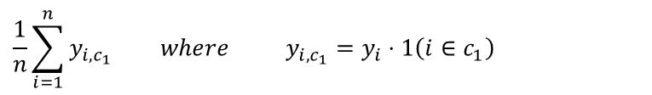
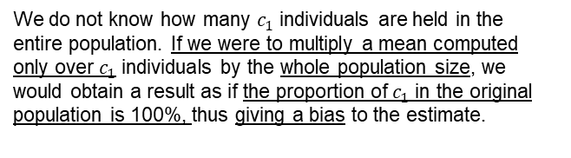
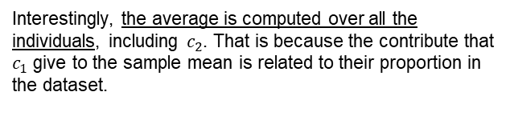
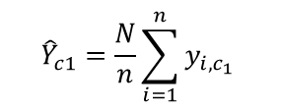
Sub-population Sampling
Consider a population where part of the individuals are labelled with a certain class $c_{1}$ and the rest with $c_{2}$. Let’s now assume we would like to estimate what is the mean of individuals from $c_{1}$ at population level.
We know how to estimate the sample mean. We just need to filter out (assign 0 to) all the individuals that do not belong
$$\frac{1}{n}\sum_{i=1}^{n}{y_{i,c_{1}}} where y_{i,c_{1}}=y_{i}⋅1\left(i∈c_{1}\right)$$
Interestingly, the average is computed over all the individuals, including $c_{2}$. That is because the contribute that $c_{1}$ give to the sample mean is related to their proportion in the dataset.
The total over the original population can be estimated by:
We do not know how many $c_{1}$ individuals are held in the entire population. If we were to multiply a mean computed only over $c_{1}$ individuals by the whole population size, we would obtain a result as if the proportion of $c_{1}$ in the original population is 100%, thus giving a bias to the estimate.
$${\hat{Y}}_{c1}=\frac{N}{n}\sum_{i=1}^{n}{y_{i,c_{1}}}$$

Slide 11
Stratified Random Sampling
This bias can occur not only by wrong estimation but also by «unlucky» random sampling. As random sampling is completely random, it is totally possible that a sample contains exclusively individuals from just one class. This incrases the variance of the estimates.
Stratified Random Sampling comes out as an alternative technique that can help mitigating this risk. Pre-requisite of this technique is knowing apriori classes included in the population and being able of separating individuals from different classes.
The solution is to estimate the mean on just one class per time, and let its contribute to the total being weighted by its participation in the sample.
$$\overline{y}=\frac{n_{c_{1}}}{n}{\overline{y}}_{c_{1}}+\frac{n_{c_{2}}}{n}{\overline{y}}_{c_{2}}$$

Slide 12
Thank You for Your Attention

